Slide 1

Design and Analysis of Algorithms
Part IV: Graph Algorithms
Lecture 10: Minimum Spanning Trees
Ke Xu and Yongxin Tong
(许可 与 童咏昕)
School of CSE, Beihang University

Slide 2
Outline
Review to Part IV
Minimum Spanning Trees
Spanning trees
Minimum spanning trees
Prim’s algorithm
The idea
The algorithm
Analysis for Prim’s algorithm
Kruskal’s algorithm
The idea
The algorithm
The Disjoint Set Union-Find data structure
Analysis for Kruskal’s algorithm

Slide 3
Outline
Review to Part IV
Minimum Spanning Trees
Spanning trees
Minimum spanning trees
Prim’s algorithm
The idea
The algorithm
Analysis for Prim’s algorithm
Kruskal’s algorithm
The idea
The algorithm
The Disjoint Set Union-Find data structure
Analysis for Kruskal’s algorithm

Slide 4
Introduction to Part IV
In Part IV, we will illustrate several graph algorithm problems using several examples:
Basic Concepts of Graphs (图的基本概念)
Breadth-First Search [BFS] (广度优先搜索)
Depth-First Search [DFS] (深度优先搜索)
Topological Sort (拓扑排序)
Strongly Connected Components (强联通分量)
Minimum Spanning Trees (最小生成树)
Shortest Path (最短路径)
All-Pairs Shortest Paths (所有结点对的最短路径)
Maximum/Network Flows (最大流/网络流)

Slide 5
Introduction to Part IV
In Part IV, we will illustrate several graph algorithm problems using several examples:
Basic Concepts of Graphs (图的基本概念)
Breadth-First Search [BFS] (广度优先搜索)
Depth-First Search [DFS] (深度优先搜索)
Topological Sort (拓扑排序)
Strongly Connected Components (强联通分量)
Minimum Spanning Trees (最小生成树)
Shortest Path (最短路径)
All-Pairs Shortest Paths (所有结点对的最短路径)
Maximum/Network Flows (最大流/网络流)

Slide 6
Outline
Review to Part IV
Minimum Spanning Trees
Spanning trees
Minimum spanning trees
Prim’s algorithm
The idea
The algorithm
Analysis for Prim’s algorithm
Kruskal’s algorithm
The idea
The algorithm
The Disjoint Set Union-Find data structure
Analysis for Kruskal’s algorithm

Slide 7
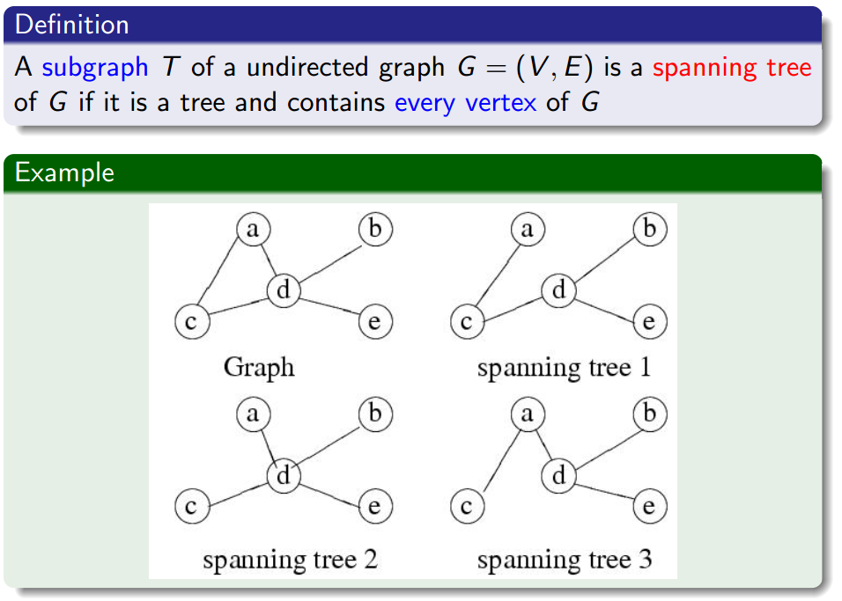
Spanning Trees

Slide 8
Spanning Trees

Slide 9
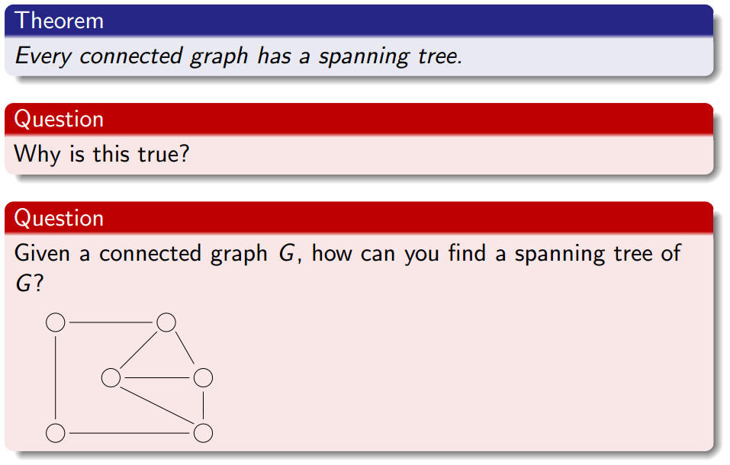
Spanning Trees

Slide 10
Spanning Trees

Slide 11
Spanning Trees

Slide 12
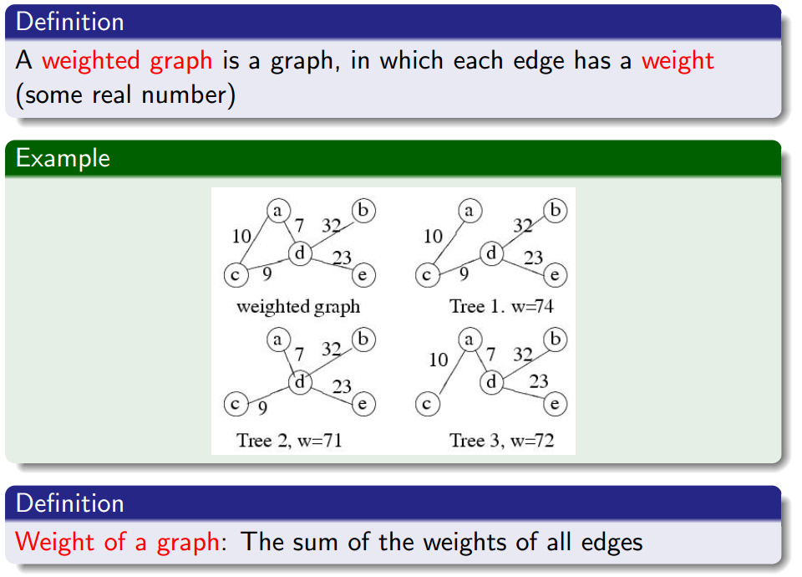
Weighted Graphs

Slide 13
Weighted Graphs

Slide 14
Weighted Graphs

Slide 15
Outline
Review to Part IV
Minimum Spanning Trees
Spanning trees
Minimum Spanning Trees
Prim’s algorithm
The idea
The algorithm
Analysis for Prim’s algorithm
Kruskal’s algorithm
The idea
The algorithm
The Disjoint Set Union-Find data structure
Analysis for Kruskal’s algorithm

Slide 16
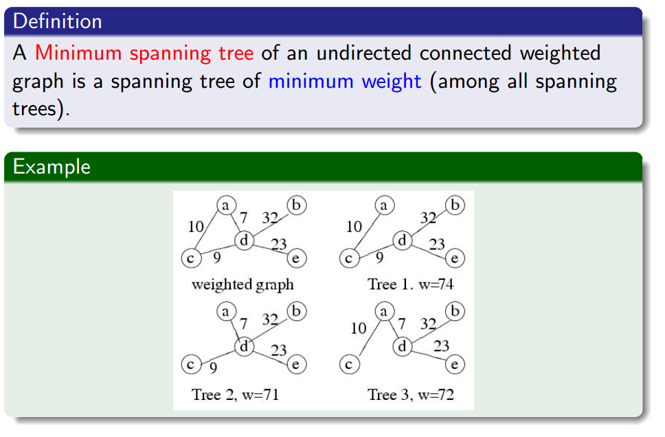
Minimum Spanning Trees

Slide 17
Minimum Spanning Trees

Slide 18
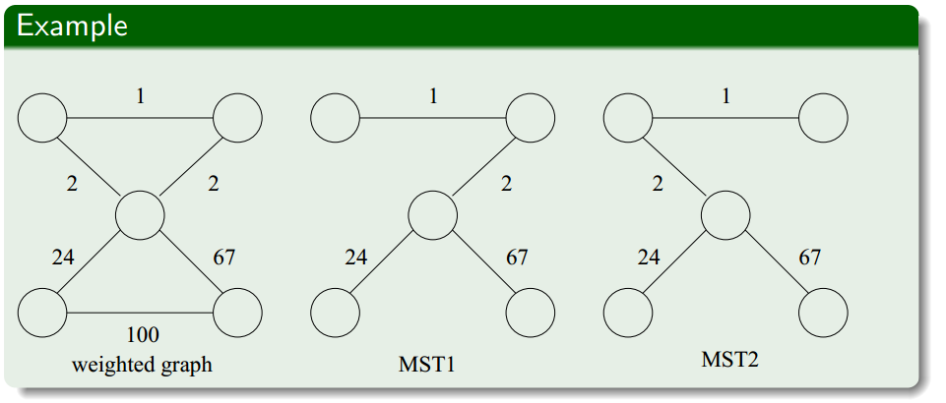
Remark
The minimum spanning tree may not be unique

Slide 19
Remark
The minimum spanning tree may not be unique
However, if the weights of all the edges are distinct, it is indeed unique (we won’t prove this now)

Slide 20
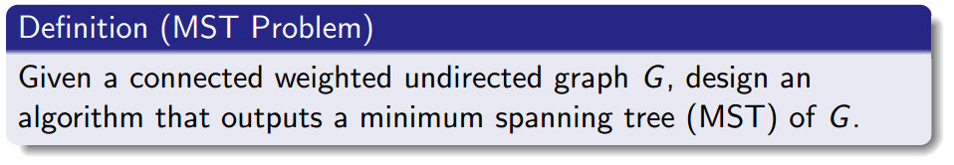
Minimum Spanning Tree Problem

Slide 21
General strategy for solving the MST Problem
A tree is an acyclic graph
start with an empty graph.

Slide 22
General strategy for solving the MST Problem
A tree is an acyclic graph
start with an empty graph.
try to add edges one at a time, always making sure that what is built remains acyclic.

Slide 23
General strategy for solving the MST Problem
A tree is an acyclic graph
start with an empty graph.
try to add edges one at a time, always making sure that what is built remains acyclic.
if after adding each edge we are sure that the resulting graph is a subset of some minimum spanning trees, we are done.

Slide 24
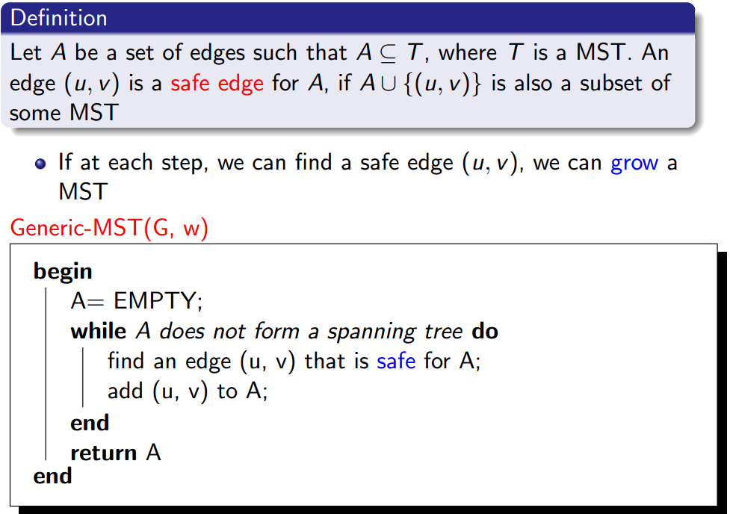
Generic Algorithm for MST problem

Slide 25
Generic Algorithm for MST problem

Slide 26
Generic Algorithm for MST problem

Slide 27
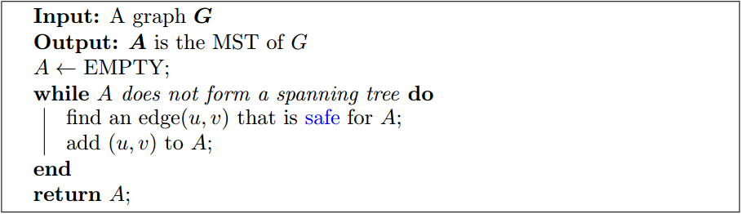
Generic Algorithm for MST problem

Slide 28
Generic Algorithm for MST problem

Slide 29
Generic Algorithm for MST problem

Slide 30
Generic Algorithm for MST problem

Slide 31
Generic Algorithm for MST problem

Slide 32
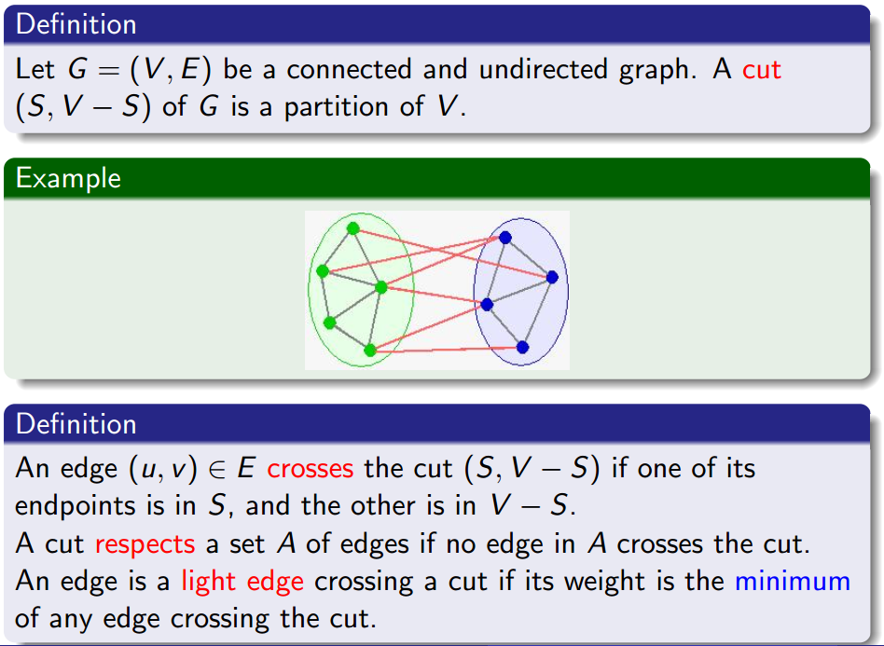
Some Definitions

Slide 33
Some Definitions

Slide 34
Some Definitions

Slide 35
Some Definitions

Slide 36
Some Definitions

Slide 37
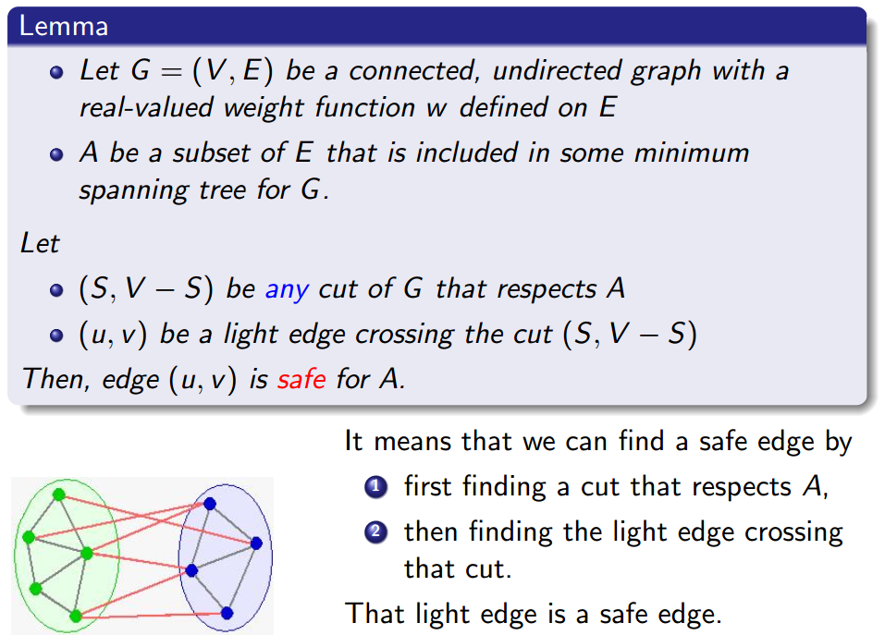
How to Find a Safe Edge?

Slide 38
How to Find a Safe Edge?

Slide 39
How to Find a Safe Edge?

Slide 40
How to Find a Safe Edge?

Slide 41
How to Find a Safe Edge?

Slide 42
How to Find a Safe Edge?

Slide 43
How to Find a Safe Edge?

Slide 44
How to Find a Safe Edge?

Slide 45
Proof
Let A ⊆ T, where T is a MST.

Slide 46
Proof
Let A ⊆ T, where T is a MST.
Case 1: (u, v) ∈ T

Slide 47
Proof
Let A ⊆ T, where T is a MST.
Case 1: (u, v) ∈ T
A ∪ {(u, v)} ⊆ T.
Hence (u, v) is safe for A.

Slide 48
Proof (cont’d)
Case 2: (u, v) ∉ T

Slide 49
Proof (cont’d)
Case 2: (u, v) ∉ T
Idea: construct another MST T’ s.t. A∪{(u, v)} ⊆ T’.

Slide 50
Proof (cont’d)
Case 2: (u, v) ∉ T
Idea: construct another MST T’ s.t. A∪{(u, v)} ⊆ T’.
Consider a path P in T from u to v.

Slide 51
Proof (cont’d)
Case 2: (u, v) ∉ T
Idea: construct another MST T’ s.t. A∪{(u, v)} ⊆ T’.
Consider a path P in T from u to v.
Since u and v are on opposite sides of the cut (S, V−S),
There is at least one edge in P that crosses the cut.

Slide 52
Proof (cont’d)
Case 2: (u, v) ∉ T
Idea: construct another MST T’ s.t. A∪{(u, v)} ⊆ T’.
Consider a path P in T from u to v.
Since u and v are on opposite sides of the cut (S, V−S),
There is at least one edge in P that crosses the cut.
Let (x, y) be such an edge.

Slide 53
Proof (cont’d)
Case 2: (u, v) ∉ T
Idea: construct another MST T’ s.t. A∪{(u, v)} ⊆ T’.
Consider a path P in T from u to v.
Since u and v are on opposite sides of the cut (S, V−S),
There is at least one edge in P that crosses the cut.
Let (x, y) be such an edge.
Since the cut respects A, (x, y) ∉ A.

Slide 54
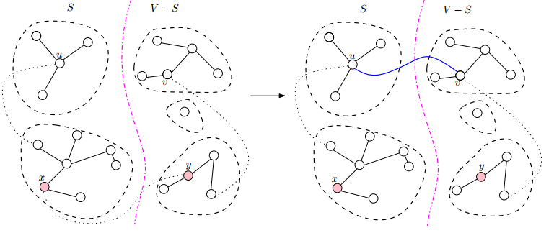
Proof (cont’d)
Case 2: (u, v) ∉ T
Idea: construct another MST T’ s.t. A∪{(u, v)} ⊆ T’.
Consider a path P in T from u to v.
Since u and v are on opposite sides of the cut (S, V−S),
There is at least one edge in P that crosses the cut.
Let (x, y) be such an edge.
Since the cut respects A, (x, y) ∉ A.
Since (u, v) is a light edge crossing the cut, we have w(x, y) ≥ w(u, v).

Slide 55
Proof (cont’d)
Add (u, v) to T, it creates a cycle. By removing an edge from the cycle, it becomes a tree again. In particular, we remove (x, y) (∉ A) to make a new tree T’.

Slide 56
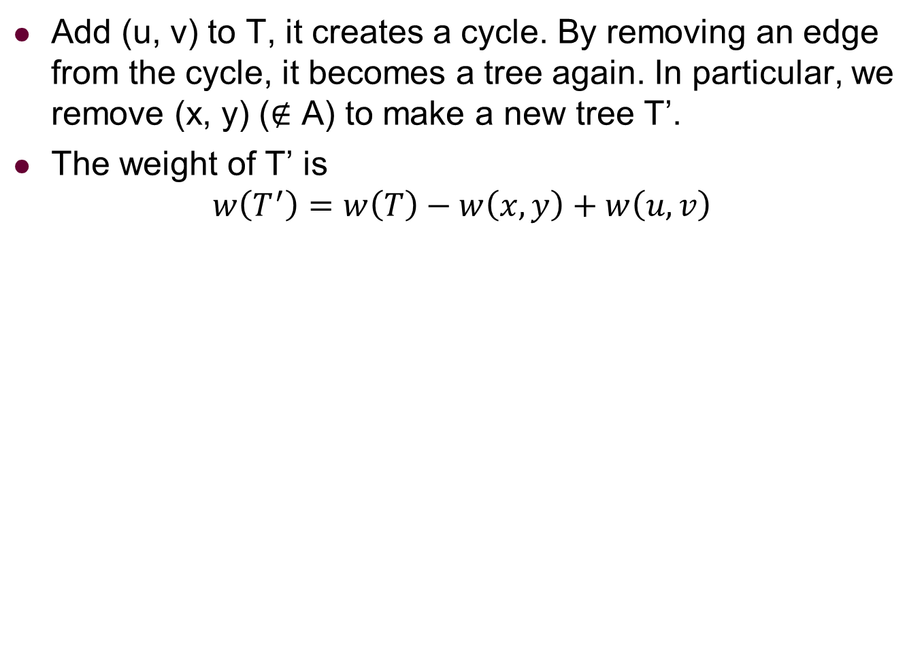
Proof (cont’d)
Add (u, v) to T, it creates a cycle. By removing an edge from the cycle, it becomes a tree again. In particular, we remove (x, y) (∉ A) to make a new tree T’.
The weight of T’ is
$$w\left(T^{′}\right)=w\left(T\right)−w\left(x,y\right)+w\left(u,v\right)$$

Slide 57

Proof (cont’d)
Add (u, v) to T, it creates a cycle. By removing an edge from the cycle, it becomes a tree again. In particular, we remove (x, y) (∉ A) to make a new tree T’.
The weight of T’ is
$$w\left(T^{′}\right)=w\left(T\right)−w\left(x,y\right)+w\left(u,v\right) \\ ≤w(T)$$

Slide 58
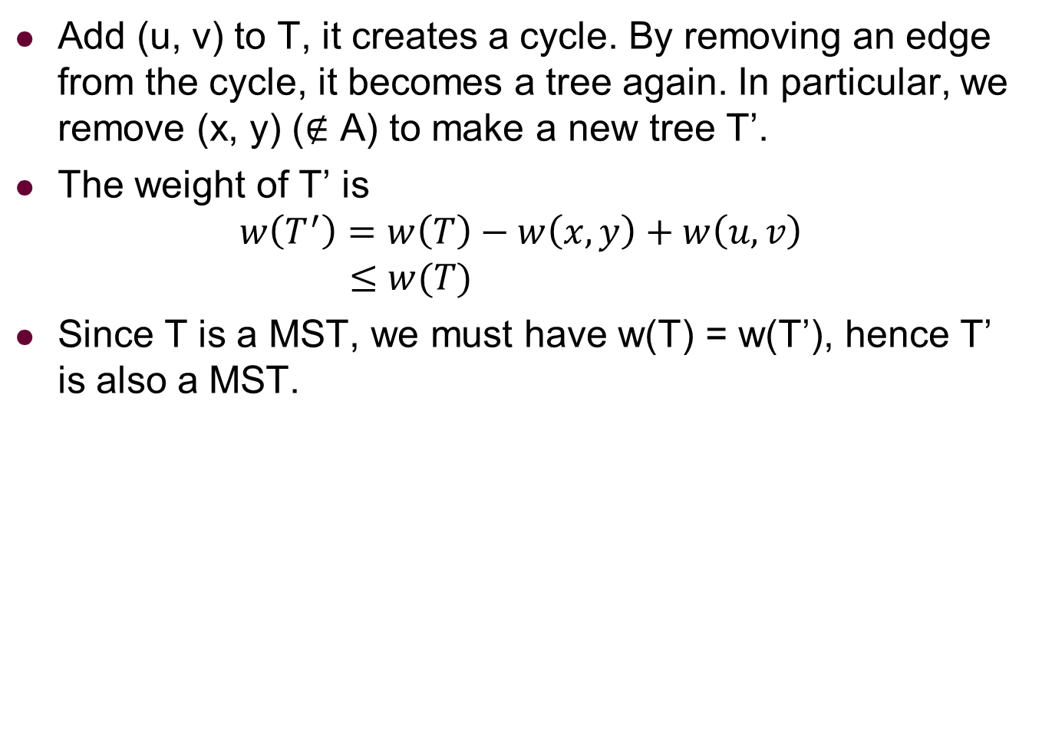
Proof (cont’d)
Add (u, v) to T, it creates a cycle. By removing an edge from the cycle, it becomes a tree again. In particular, we remove (x, y) (∉ A) to make a new tree T’.
The weight of T’ is
$$w\left(T^{′}\right)=w\left(T\right)−w\left(x,y\right)+w\left(u,v\right) \\ ≤w(T)$$
Since T is a MST, we must have w(T) = w(T’), hence T’ is also a MST.

Slide 59
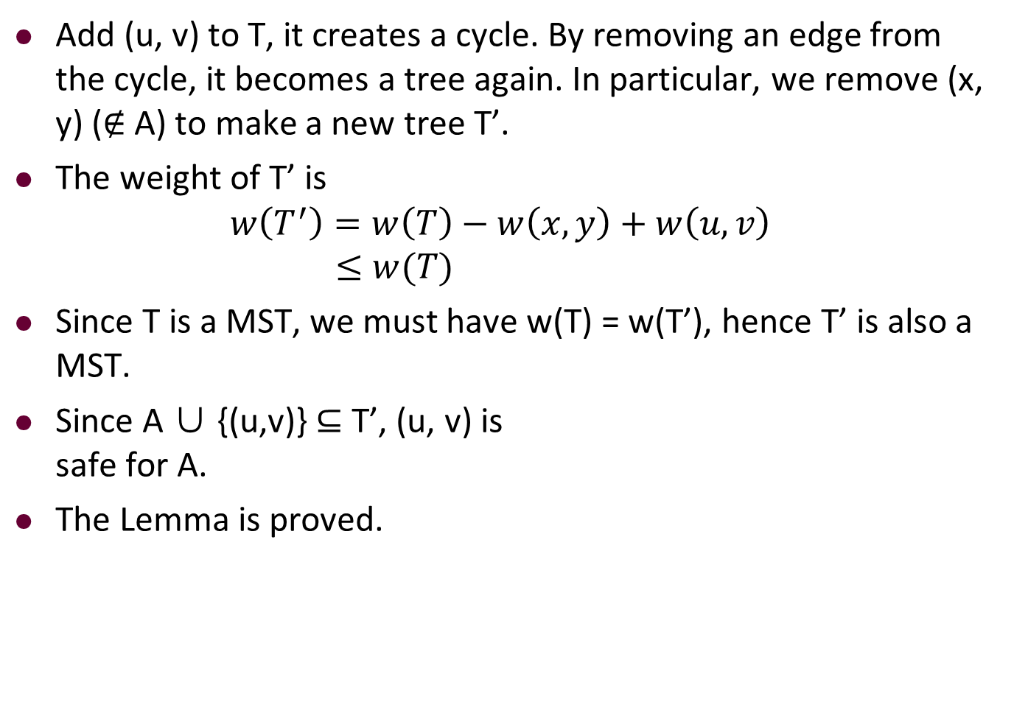
Proof (cont’d)
Add (u, v) to T, it creates a cycle. By removing an edge from the cycle, it becomes a tree again. In particular, we remove (x, y) (∉ A) to make a new tree T’.
The weight of T’ is
$$w\left(T^{′}\right)=w\left(T\right)−w\left(x,y\right)+w\left(u,v\right) \\ ≤w(T)$$
Since T is a MST, we must have w(T) = w(T’), hence T’ is also a MST.
Since A ∪ {(u,v)} ⊆ T’, (u, v) is safe for A.
The Lemma is proved.

Slide 60
Outline
Review to Part IV
Minimum Spanning Trees
Spanning trees
Minimum spanning trees
Prim’s algorithm
The idea
The algorithm
Analysis for Prim’s algorithm
Kruskal’s algorithm
The idea
The algorithm
The Disjoint Set Union-Find data structure
Analysis for Kruskal’s algorithm

Slide 61
Prim’s Algorithm
The generic algorithm gives us an idea how to ’grow’ a MST.

Slide 62
Prim’s Algorithm
The generic algorithm gives us an idea how to ’grow’ a MST.
If you read the theorem and the proof carefully, you will notice that the choice of a cut (and hence the corresponding light edge) in each iteration is arbitrary.

Slide 63
Prim’s Algorithm
The generic algorithm gives us an idea how to ’grow’ a MST.
If you read the theorem and the proof carefully, you will notice that the choice of a cut (and hence the corresponding light edge) in each iteration is arbitrary.
We can select any cut (that respects the selected edges) and find the light edge crossing that cut to proceed.

Slide 64
Prim’s Algorithm
The generic algorithm gives us an idea how to ’grow’ a MST.
If you read the theorem and the proof carefully, you will notice that the choice of a cut (and hence the corresponding light edge) in each iteration is arbitrary.
We can select any cut (that respects the selected edges) and find the light edge crossing that cut to proceed.
Prim’s algorithm makes a nature choice of the cut in each Iteration

Slide 65
Prim’s Algorithm
The generic algorithm gives us an idea how to ’grow’ a MST.
If you read the theorem and the proof carefully, you will notice that the choice of a cut (and hence the corresponding light edge) in each iteration is arbitrary.
We can select any cut (that respects the selected edges) and find the light edge crossing that cut to proceed.
Prim’s algorithm makes a nature choice of the cut in each Iteration
grows a single tree and adds a light edge in each iteration.

Slide 66
Prim’s Algorithm
The generic algorithm gives us an idea how to ’grow’ a MST.
If you read the theorem and the proof carefully, you will notice that the choice of a cut (and hence the corresponding light edge) in each iteration is arbitrary.
We can select any cut (that respects the selected edges) and find the light edge crossing that cut to proceed.
Prim’s algorithm makes a nature choice of the cut in each Iteration
grows a single tree and adds a light edge in each iteration.
Grow a tree

Slide 67
Prim’s Algorithm
The generic algorithm gives us an idea how to ’grow’ a MST.
If you read the theorem and the proof carefully, you will notice that the choice of a cut (and hence the corresponding light edge) in each iteration is arbitrary.
We can select any cut (that respects the selected edges) and find the light edge crossing that cut to proceed.
Prim’s algorithm makes a nature choice of the cut in each Iteration
grows a single tree and adds a light edge in each iteration.
Grow a tree
Start by picking any vertex r to be the root of the tree.

Slide 68
Prim’s Algorithm
The generic algorithm gives us an idea how to ’grow’ a MST.
If you read the theorem and the proof carefully, you will notice that the choice of a cut (and hence the corresponding light edge) in each iteration is arbitrary.
We can select any cut (that respects the selected edges) and find the light edge crossing that cut to proceed.
Prim’s algorithm makes a nature choice of the cut in each Iteration
grows a single tree and adds a light edge in each iteration.
Grow a tree
Start by picking any vertex r to be the root of the tree.
While the tree does not contain all vertices in the graph:

Slide 69
Prim’s Algorithm
The generic algorithm gives us an idea how to ’grow’ a MST.
If you read the theorem and the proof carefully, you will notice that the choice of a cut (and hence the corresponding light edge) in each iteration is arbitrary.
We can select any cut (that respects the selected edges) and find the light edge crossing that cut to proceed.
Prim’s algorithm makes a nature choice of the cut in each Iteration
grows a single tree and adds a light edge in each iteration.
Grow a tree
Start by picking any vertex r to be the root of the tree.
While the tree does not contain all vertices in the graph: find shortest edge leaving the tree and add it to the tree.

Slide 70
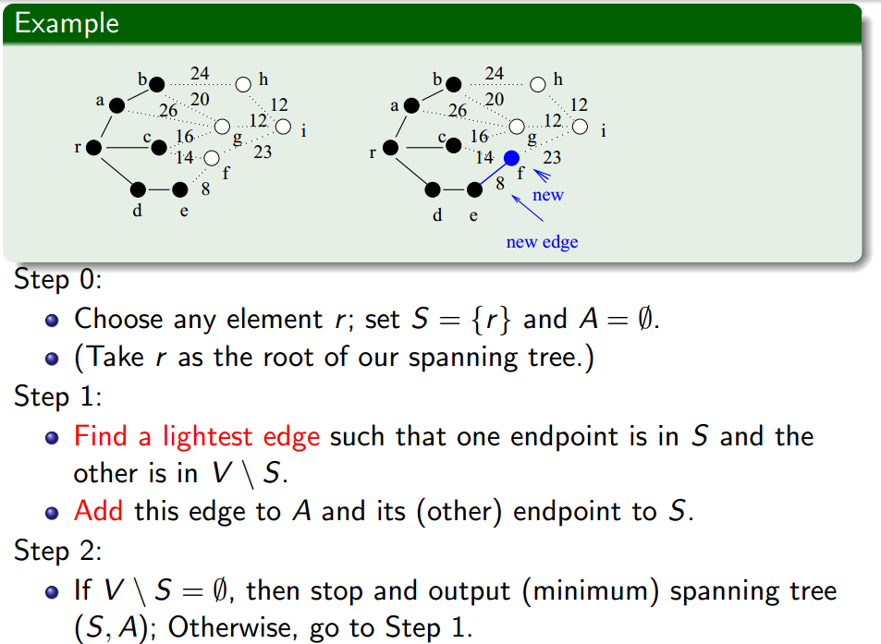
More Details

Slide 71
More Details

Slide 72
More Details

Slide 73
More Details

Slide 74
Prim's Example
2
10
5
Connected graph
4
8
7
6
1
9
4
5
7
8
2
2
2
3
6
1
2
10
5
Step 0
S = {1}
V \ S = {2,3,4,5,6,7}
lightest edge = {1,2}
4
8
7
6
1
9
4
5
7
8
2
2
2
3
6
1

Slide 75
Prim's Example
2
10
5
Step 1.1 before
S = {1}
V \ S = {2,3,4,5,6,7}
A={}
lightest edge = {1,2}
4
8
7
6
1
9
4
5
7
8
2
2
2
3
6
1
2
10
5
Step 1.1 after
S = {1,2}
V \ S = {3,4,5,6,7}
A = { {1,2} }
lightest edge = {1,3},{2,4}
4
8
7
6
1
9
4
5
7
8
2
2
2
3
6
1

Slide 76
Prim's Example
2
10
5
Step 1.2 before
S = {1,2}
V \ S = {3,4,5,6,7}
A = { {1,2} }
lightest edge = {1,3},{2,4}
4
8
7
6
1
9
4
5
7
8
2
2
2
3
6
1
2
10
5
Step 1.2 after
S = {1,2,3}
V \ S = {4,5,6,7}
A = { {1,2},{1,3} }
lightest edge = {3,6}
4
8
7
6
1
9
4
5
7
8
2
2
2
3
6
1

Slide 77
Prim's Example
2
10
5
Step 1.3 before
S = {1,2,3}
V \ S = {4,5,6,7}
A = { {1,2},{1,3} }
lightest edge = {3,6}
4
8
7
6
1
9
4
5
7
8
2
2
2
3
6
1
2
10
5
Step 1.3 after
S = {1,2,3,6}
V \ S = {4,5,7}
A = { {1,2},{1,3},{3,6} }
lightest edge = {3,4},{6,4},{6,7}
4
8
7
6
1
9
4
5
7
8
2
2
2
3
6
1

Slide 78
Prim's Example
2
10
5
Step 1.4 before
S = {1,2,3,6}
V \ S = {4,5,7}
A = { {1,2},{1,3},{3,6} }
lightest edge = {3,4},{6,4},{6,7}
4
8
7
6
1
9
4
5
7
8
2
2
2
3
6
1
2
10
5
Step 1.4 after
S = {1,2,3,4,6}
V \ S = {5,7}
A = { {1,2},{1,3},{3,6},{3,4} }
lightest edge = {6,7}
4
8
7
6
1
9
4
5
7
8
2
2
2
3
6
1

Slide 79
Prim's Example
2
10
5
Step 1.5 before
S = {1,2,3,4,6}
V \ S = {5,7}
A = { {1,2},{1,3},{3,6},{3,4} }
lightest edge = {6,7}
4
8
7
6
1
9
4
5
7
8
2
2
2
3
6
1
2
10
5
Step 1.5 after
S = {1,2,3,4,6,7}
V \ S = {5}
A = { {1,2},{1,3},{3,6},{3,4},{6,7} }
lightest edge = {6,5}
4
8
7
6
1
9
4
5
7
8
2
2
2
3
6
1

Slide 80
Prim's Example
2
10
5
Step 1.6 before
S = {1,2,3,4,6,7}
V \ S = {5}
A = { {1,2},{1,3},{3,6},{3,4},{6,7} }
lightest edge = {6,5}
4
8
7
6
1
9
4
5
7
8
2
2
2
3
6
1
2
10
5
Step 1.6 after
S = {1,2,3,4,5,6,7}
V \ S = {}
A = { {1,2},{1,3},{3,6},{3,4},{6,7},
{6,5} }
MST completed
4
8
7
6
1
9
4
5
7
8
2
2
2
3
6
1

Slide 81
Outline
Review to Part IV
Minimum Spanning Trees
Spanning trees
Minimum spanning trees
Prim’s algorithm
The idea
The algorithm
Analysis for Prim’s algorithm
Kruskal’s algorithm
The idea
The algorithm
The Disjoint Set Union-Find data structure
Analysis for Kruskal’s algorithm

Slide 82
Recall Idea of Prim’s Algorithm
Step 0: Choose any element r and set S = {r} and A = ∅. (Take r as the root of our spanning tree.)
Step 1: Find a lightest edge such that one endpoint is in S and the other is in V \ S. Add this edge to A and its (other) endpoint to S.
Step 2: If V \ S = ∅, then stop and output the minimum spanning tree (S,A); Otherwise go to Step 1.

Slide 83
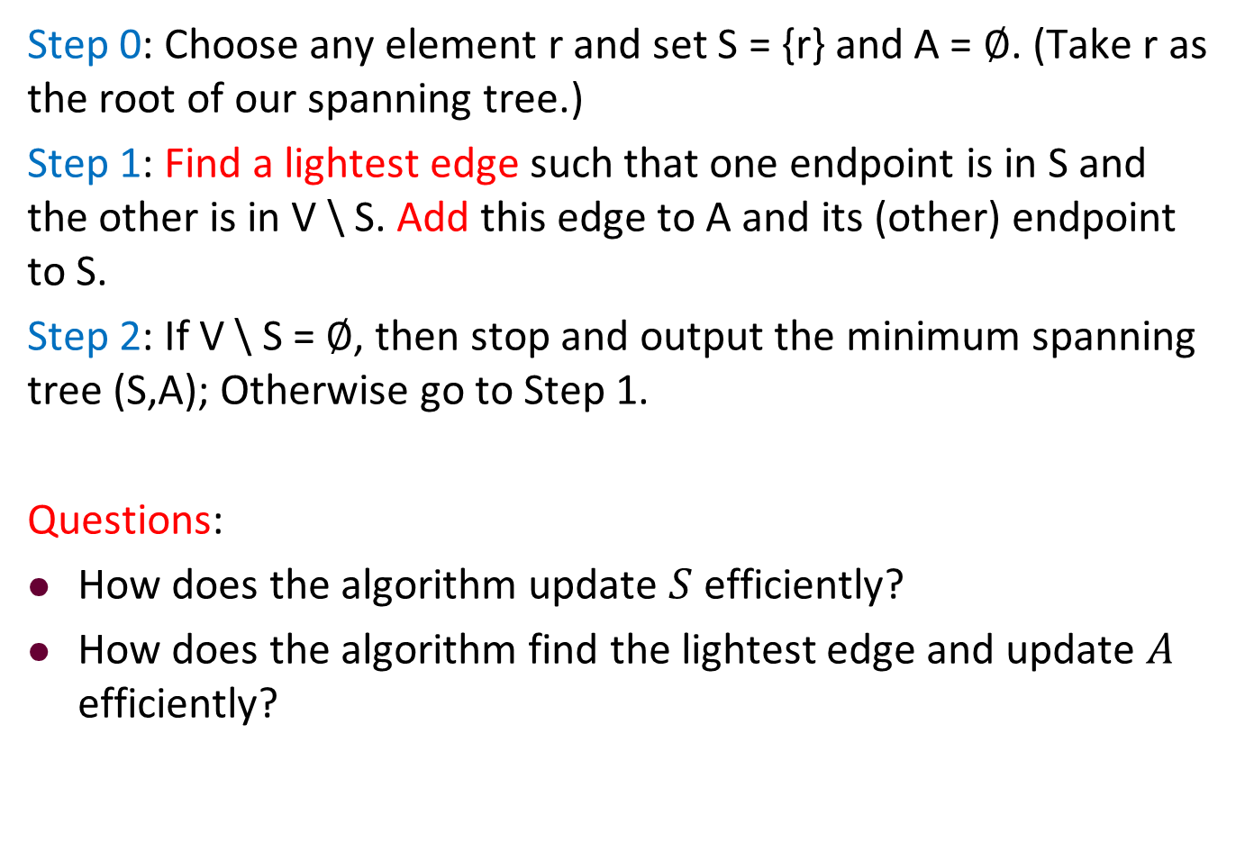
Recall Idea of Prim’s Algorithm
Step 0: Choose any element r and set S = {r} and A = ∅. (Take r as the root of our spanning tree.)
Step 1: Find a lightest edge such that one endpoint is in S and the other is in V \ S. Add this edge to A and its (other) endpoint to S.
Step 2: If V \ S = ∅, then stop and output the minimum spanning tree (S,A); Otherwise go to Step 1.
Questions:
How does the algorithm update $S$ efficiently?
How does the algorithm find the lightest edge and update $A$ efficiently?

Slide 84
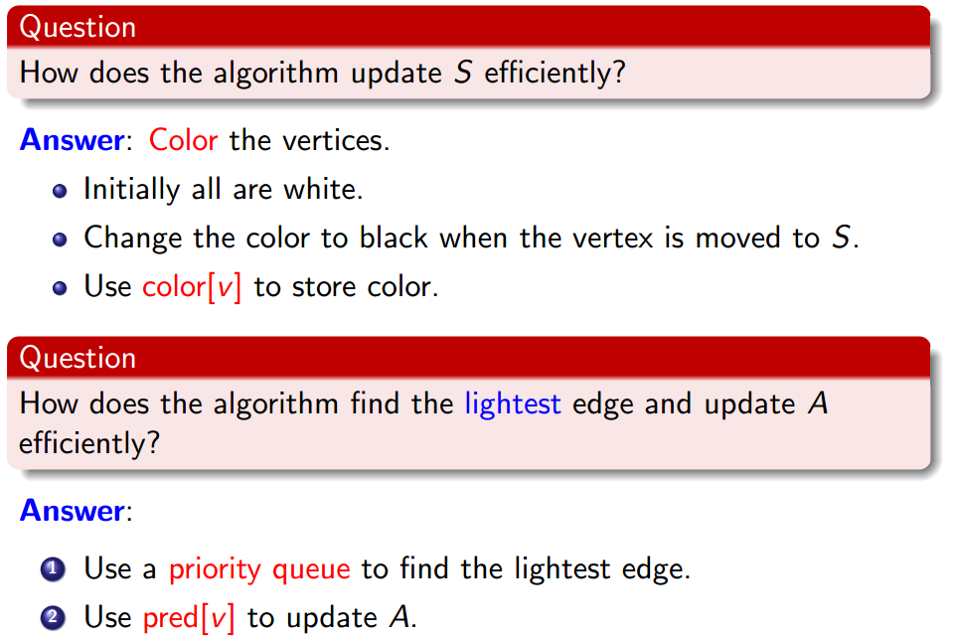
Prim’s Algorithm

Slide 85
Prim’s Algorithm

Slide 86
Prim’s Algorithm

Slide 87
Prim’s Algorithm

Slide 88
Prim’s Algorithm

Slide 89
Prim’s Algorithm

Slide 90
Prim’s Algorithm

Slide 91
Reviewing Priority Queues
Priority Queue is a data structure

Slide 92

Reviewing Priority Queues
Priority Queue is a data structure

Slide 93
Reviewing Priority Queues
Priority Queue is a data structure
can be implemented as a heap

Slide 94
Reviewing Priority Queues
Priority Queue is a data structure
can be implemented as a heap
Supports the following operations:

Slide 95
Reviewing Priority Queues
Priority Queue is a data structure
can be implemented as a heap
Supports the following operations:
Insert(u, key): Insert u with the key value key in Q.

Slide 96
Reviewing Priority Queues
Priority Queue is a data structure
can be implemented as a heap
Supports the following operations:
Insert(u, key): Insert u with the key value key in Q.
u = Extract-Min(): Extract the item with minimum key value.

Slide 97
Reviewing Priority Queues
Priority Queue is a data structure
can be implemented as a heap
Supports the following operations:
Insert(u, key): Insert u with the key value key in Q.
u = Extract-Min(): Extract the item with minimum key value.
Decrease-Key(u, new-key): Decrease u’s key value to new-key.

Slide 98
Reviewing Priority Queues
Priority Queue is a data structure
can be implemented as a heap
Supports the following operations:
Insert(u, key): Insert u with the key value key in Q.
u = Extract-Min(): Extract the item with minimum key value.
Decrease-Key(u, new-key): Decrease u’s key value to new-key.
Remark: Priority Queues can be implemented so that each operation takes time O(log |Q|). See Lecture 5 & Chapter 6.5 CLRS.

Slide 99
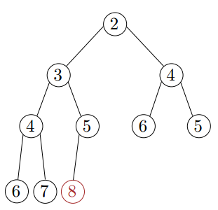
Reviewing Extract-Min
Copy the last element to the root (i.e., overwrite the minimum element stored there)
Restore the min-heap property by percolate down (or bubble down): if the element is larger than either of its children, then interchange it with the smaller of its children.

Slide 100
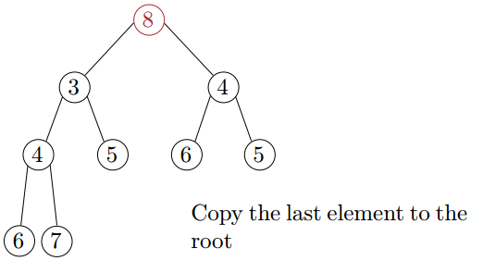
Reviewing Extract-Min
Copy the last element to the root (i.e., overwrite the minimum element stored there)
Restore the min-heap property by percolate down (or bubble down): if the element is larger than either of its children, then interchange it with the smaller of its children.

Slide 101
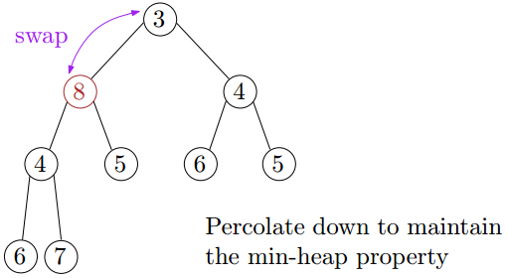
Reviewing Extract-Min
Copy the last element to the root (i.e., overwrite the minimum element stored there)
Restore the min-heap property by percolate down (or bubble down): if the element is larger than either of its children, then interchange it with the smaller of its children.

Slide 102
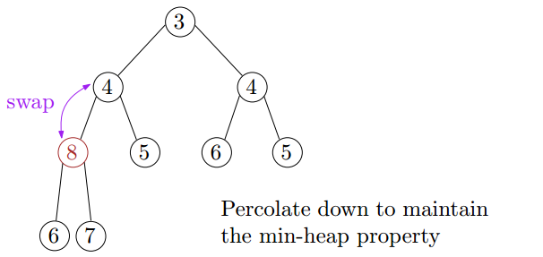
Reviewing Extract-Min
Copy the last element to the root (i.e., overwrite the minimum element stored there)
Restore the min-heap property by percolate down (or bubble down): if the element is larger than either of its children, then interchange it with the smaller of its children.

Slide 103
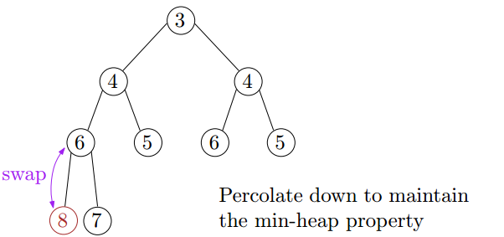
Reviewing Extract-Min
Copy the last element to the root (i.e., overwrite the minimum element stored there)
Restore the min-heap property by percolate down (or bubble down): if the element is larger than either of its children, then interchange it with the smaller of its children.
Correctness: after each swap, the min-heap property is satisfied for all nodes except the node containing the element (with respect to its children)

Slide 104
Reviewing Extract-Min
Copy the last element to the root (i.e., overwrite the minimum element stored there)
Restore the min-heap property by percolate down (or bubble down): if the element is larger than either of its children, then interchange it with the smaller of its children.
Correctness: after each swap, the min-heap property is satisfied for all nodes except the node containing the element (with respect to its children)
Time complexity = O(height) = O(log n)

Slide 105
Using a Priority Queue to Find the Lightest Edge
Each item of the queue is a pair (u, key[u]),

Slide 106
Using a Priority Queue to Find the Lightest Edge
Each item of the queue is a pair (u, key[u]), where
u is a vertex in V\S,

Slide 107
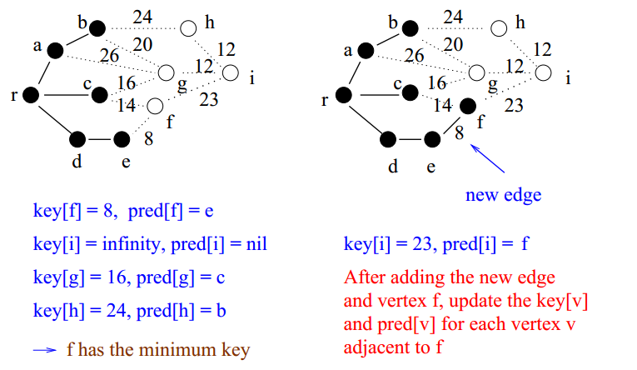
Using a Priority Queue to Find the Lightest Edge
Each item of the queue is a pair (u, key[u]), where
u is a vertex in V\S,
key[u] is the weight of the lightest edge from u to any vertex in S. (The endpoint of this edge in S is stored in pred[u], which is used to build the MST tree.)

Slide 108
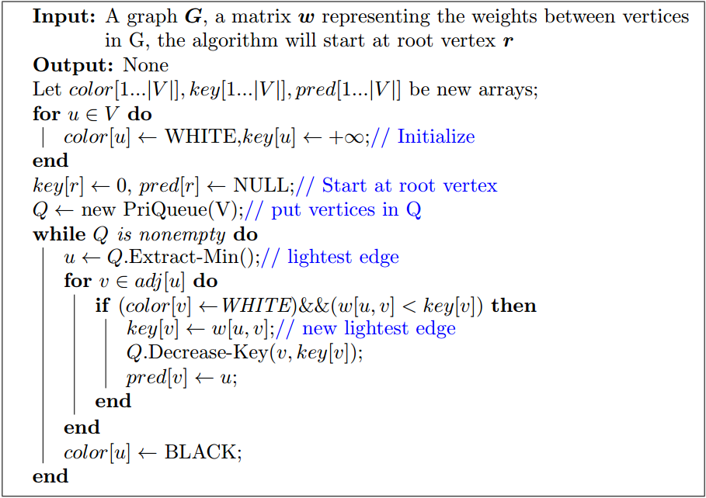
Description of Prim’s Algorithm

Slide 109
Description of Prim’s Algorithm

Slide 110
Description of Prim’s Algorithm

Slide 111
Description of Prim’s Algorithm

Slide 112
Description of Prim’s Algorithm

Slide 113
Description of Prim’s Algorithm

Slide 114
Description of Prim’s Algorithm

Slide 115
Description of Prim’s Algorithm

Slide 116
Description of Prim’s Algorithm

Slide 117
Description of Prim’s Algorithm

Slide 118
Description of Prim’s Algorithm

Slide 119
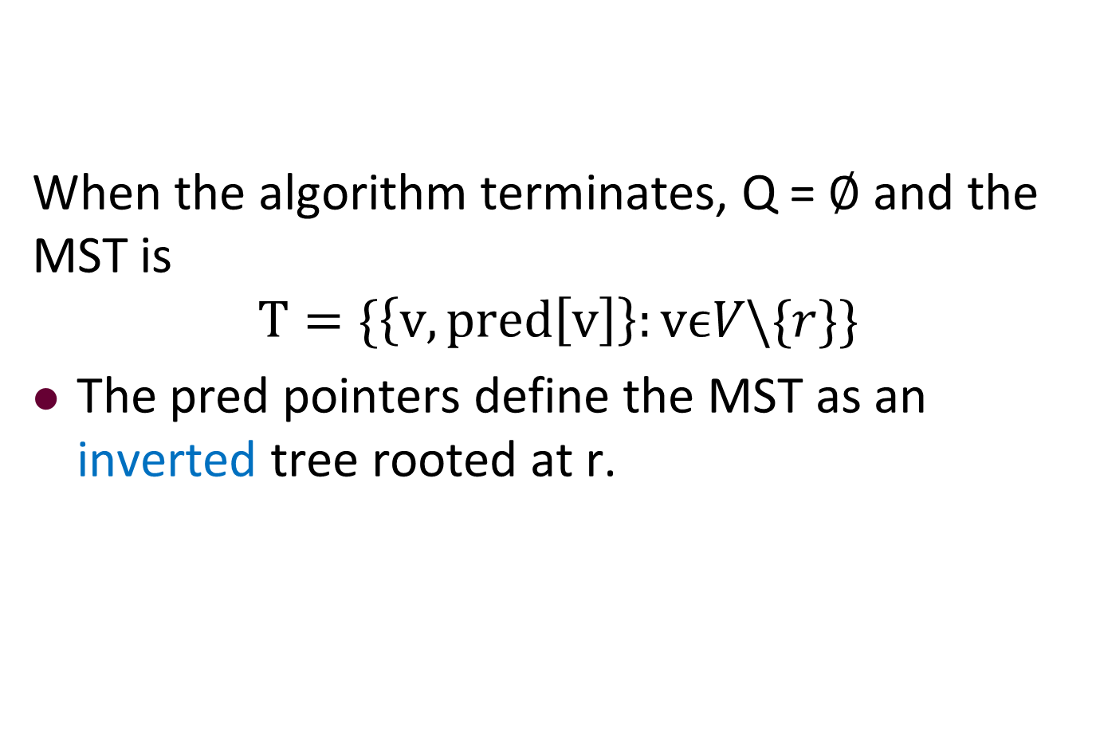
Description of Prim’s Algorithm
When the algorithm terminates, Q = ∅ and the MST is
$$T=\{\left\{v,pred\left[v\right]\right\}:vϵV\backslash \{r\}\}$$
The pred pointers define the MST as an inverted tree rooted at r.

Slide 120
Prim's Example
color
pred
W
W
W
W
W
W
W
N
N
N
N
N
N
N
key
Q
∞
∞
∞
∞
∞
∞
∞
1,∞
2,∞
3,∞
4,∞
5,∞
6,∞
7,∞
2
10
5
4
8
7
6
1
9
4
7
5
8
2
2
2
3
6
1

Slide 121
Prim's Example
color
pred
W
W
W
W
W
W
W
N
N
N
N
N
N
N
key
Q
∞
∞
∞
∞
∞
∞
∞
1,∞
2,∞
3,∞
4,∞
5,∞
6,∞
7,∞
2
10
5
4
8
7
6
Start from this vertex
1
9
4
7
5
8
2
2
2
3
6
1

Slide 122
Prim's Example
color
pred
B
W
W
W
W
W
W
N
N
N
N
N
N
N
key
Q
0
∞
∞
∞
∞
∞
∞
1,0
2,∞
3,∞
4,∞
5,∞
6,∞
7,∞
2
10
5
4
8
7
6
1
9
4
7
5
8
2
2
2
3
6
1

Slide 123
Prim's Example
color
pred
B
W
W
W
W
W
W
N
N
N
N
N
N
N
key
Q
0
∞
∞
∞
∞
∞
∞
7,∞
2,∞
3,∞
4,∞
5,∞
6,∞
2
10
5
4
8
7
6
1
9
4
7
5
8
2
2
2
3
6
1

Slide 124
Prim's Example
color
pred
B
W
W
W
W
W
W
N
1
1
N
N
N
N
key
Q
0
4
8
∞
∞
∞
∞
7,∞
2,4
3,8
4,∞
5,∞
6,∞
2
10
5
4
8
7
6
1
9
4
7
5
8
2
2
2
3
6
1

Slide 125
Prim's Example
color
pred
B
W
W
W
W
W
W
N
1
1
N
N
N
N
key
Q
0
4
8
∞
∞
∞
∞
2,4
7,∞
3,8
4,∞
5,∞
6,∞
2
10
5
4
8
7
6
1
9
4
7
5
8
2
2
2
3
6
1

Slide 126
Prim's Example
color
pred
B
B
W
W
W
W
W
N
1
1
N
N
N
N
key
Q
0
4
8
∞
∞
∞
∞
3,8
7,∞
6,∞
4,∞
5,∞
2
10
5
4
8
7
6
1
9
4
7
5
8
2
2
2
3
6
1

Slide 127
Prim's Example
color
pred
B
B
W
W
W
W
W
N
1
1
N
N
N
N
key
Q
0
4
8
∞
∞
∞
∞
3,8
7,∞
6,∞
4,∞
5,∞
2
10
5
4
8
7
6
1
9
4
7
5
8
2
2
2
3
6
1

Slide 128
Prim's Example
color
pred
B
B
W
W
W
W
W
N
1
1
2
2
N
N
key
Q
0
4
8
8
10
∞
∞
3,8
7,∞
6,∞
4,8
5,10
2
10
5
4
8
7
6
1
9
4
7
5
8
2
2
2
We don’t need to update key[3] and pred[3] because key[3]<w[2,3]
3
6
1

Slide 129
Prim's Example
color
pred
B
B
W
W
W
W
W
N
1
1
2
2
N
N
key
Q
0
4
8
8
10
∞
∞
3,8
4,8
6,∞
7,∞
5,10
2
10
5
4
8
7
6
1
9
4
7
5
8
2
2
2
3
6
1

Slide 130
Prim's Example
color
pred
B
B
B
W
W
W
W
N
1
1
2
2
N
N
key
Q
0
4
8
8
10
∞
∞
4,8
5,10
6,∞
7,∞
2
10
5
4
8
7
6
1
9
4
7
5
8
2
2
2
3
6
1

Slide 131
Prim's Example
color
pred
B
B
B
W
W
W
W
N
1
1
2
2
N
N
key
Q
0
4
8
8
10
∞
∞
4,8
5,10
6,∞
7,∞
2
10
5
4
8
7
6
1
9
4
7
5
8
2
2
2
3
6
1

Slide 132
Prim's Example
color
pred
B
B
B
W
W
W
W
N
1
1
3
2
3
N
key
Q
0
4
8
2
10
1
∞
4,2
5,10
6,1
7,∞
2
10
5
4
8
7
6
1
9
4
7
5
8
2
2
2
3
6
1

Slide 133
Prim's Example
color
pred
B
B
B
W
W
W
W
N
1
1
3
2
3
N
key
Q
0
4
8
2
10
1
∞
6,1
5,10
4,2
7,∞
2
10
5
4
8
7
6
1
9
4
7
5
8
2
2
2
3
6
1

Slide 134
Prim's Example
color
pred
B
B
B
W
W
B
W
N
1
1
3
2
3
N
key
Q
0
4
8
2
10
1
∞
4,2
5,10
7,∞
2
10
5
4
8
7
6
1
9
4
7
5
8
2
2
2
3
6
1

Slide 135
Prim's Example
color
pred
B
B
B
W
W
B
W
N
1
1
3
2
3
N
key
Q
0
4
8
2
10
1
∞
4,2
5,10
7,∞
2
10
5
4
8
7
6
1
9
4
7
5
8
2
2
2
3
6
1

Slide 136
Prim's Example
color
pred
B
B
B
W
W
B
W
N
1
1
3
6
3
6
key
Q
0
4
8
2
5
1
2
4,2
5,5
7,2
2
10
5
4
8
7
6
1
9
4
7
5
8
2
2
2
3
6
1

Slide 137
Prim's Example
color
pred
B
B
B
W
W
B
W
N
1
1
3
6
3
6
key
Q
0
4
8
2
5
1
2
4,2
5,5
7,2
2
10
5
4
8
7
6
1
9
4
7
5
8
2
2
2
3
6
1

Slide 138
Prim's Example
color
pred
B
B
B
B
W
B
W
N
1
1
3
6
3
6
key
Q
0
4
8
2
5
1
2
7,2
5,5
2
10
5
4
8
7
6
1
9
4
7
5
8
2
2
2
3
6
1

Slide 139
Prim's Example
color
pred
B
B
B
B
W
B
W
N
1
1
3
6
3
6
key
Q
0
4
8
2
5
1
2
7,2
5,5
2
10
5
4
8
7
6
We don’t need to update key[5] and pred[5].
1
9
4
7
5
8
2
2
2
3
6
1

Slide 140
Prim's Example
color
pred
B
B
B
B
W
B
W
N
1
1
3
6
3
6
key
Q
0
4
8
2
5
1
2
7,2
5,5
2
10
5
4
8
7
6
1
9
4
7
5
8
2
2
2
3
6
1

Slide 141
Prim's Example
color
pred
B
B
B
B
W
B
B
N
1
1
3
6
3
6
key
Q
0
4
8
2
5
1
2
5,5
2
10
5
4
8
7
6
1
9
4
7
5
8
2
2
2
3
6
1

Slide 142
Prim's Example
color
pred
B
B
B
B
W
B
B
N
1
1
3
6
3
6
key
Q
0
4
8
2
5
1
2
5,5
2
10
5
4
8
7
6
1
9
4
7
5
8
2
2
2
3
6
1

Slide 143
Prim's Example
color
pred
B
B
B
B
W
B
B
N
1
1
3
6
3
6
key
Q
0
4
8
2
5
1
2
5,5
2
10
5
4
8
7
6
1
9
4
7
5
8
2
2
2
3
6
1

Slide 144
Prim's Example
color
pred
B
B
B
B
B
B
B
N
1
1
3
6
3
6
key
Q
0
4
8
2
5
1
2
2
10
5
4
8
7
6
1
9
4
7
5
8
2
2
2
3
6
1

Slide 145
Prim's Example
color
pred
B
B
B
B
B
B
B
N
1
1
3
6
3
6
key
0
4
8
2
5
1
2
Weight of MST = 22
2
10
5
4
8
7
6
1
9
4
7
5
8
2
2
2
3
6
1

Slide 146
Outline
Review to Part IV
Minimum Spanning Trees
Spanning trees
Minimum spanning trees
Prim’s algorithm
The idea
The algorithm
Analysis for Prim’s algorithm
Kruskal’s algorithm
The idea
The algorithm
The Disjoint Set Union-Find data structure
Analysis for Kruskal’s algorithm

Slide 147
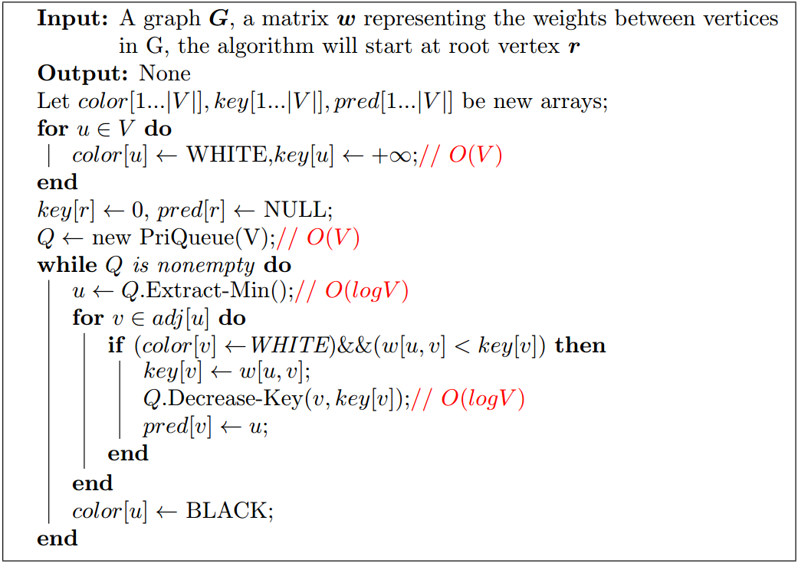
Analysis of Prim’s Algorithm...

Slide 148
Analysis of Prim’s Algorithm...

Slide 149
Analysis of Prim’s Algorithm...

Slide 150
Analysis of Prim’s Algorithm...

Slide 151
Analysis of Prim’s Algorithm...

Slide 152
Analysis of Prim’s Algorithm...

Slide 153
Analysis of Prim’s Algorithm...

Slide 154
Analysis of Prim’s Algorithm...

Slide 155
Analysis of Prim’s Algorithm
The data structure PriQueue (heap) supports the following two operations: (See CLRS)
O(log V) for Extract-Min on a PriQueue of size at most V .

Slide 156
Analysis of Prim’s Algorithm
The data structure PriQueue (heap) supports the following two operations: (See CLRS)
O(log V) for Extract-Min on a PriQueue of size at most V . Total cost: O(V log V)

Slide 157
Analysis of Prim’s Algorithm
The data structure PriQueue (heap) supports the following two operations: (See CLRS)
O(log V) for Extract-Min on a PriQueue of size at most V . Total cost: O(V log V)
O(log V) time for Decrease-Key on a PriQueue of size at most E.

Slide 158
Analysis of Prim’s Algorithm
The data structure PriQueue (heap) supports the following two operations: (See CLRS)
O(log V) for Extract-Min on a PriQueue of size at most V . Total cost: O(V log V)
O(log V) time for Decrease-Key on a PriQueue of size at most E. Total cost: O(E log V).

Slide 159
Analysis of Prim’s Algorithm
The data structure PriQueue (heap) supports the following two operations: (See CLRS)
O(log V) for Extract-Min on a PriQueue of size at most V . Total cost: O(V log V)
O(log V) time for Decrease-Key on a PriQueue of size at most E. Total cost: O(E log V).
Total cost is then O((V + E) log V) = O(E log V)

Slide 160
Outline
Review to Part IV
Minimum Spanning Trees
Spanning trees
Minimum spanning trees
Prim’s algorithm
The idea
The algorithm
Analysis for Prim’s algorithm
Kruskal’s algorithm
The idea
The algorithm
The Disjoint Set Union-Find data structure
Analysis for Kruskal’s algorithm

Slide 161
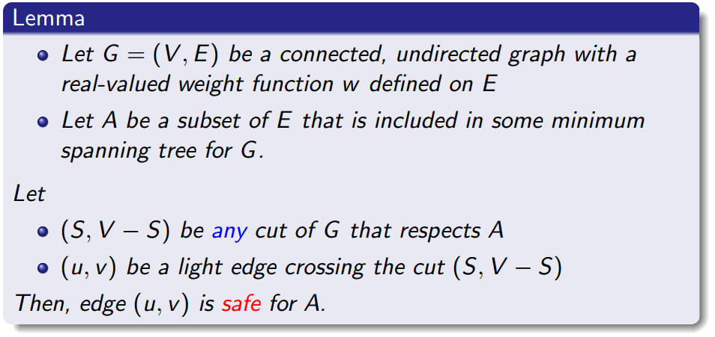
Recalling the Generic Algorithm
Start with an empty graph.
Try to add edges one at a time, always making sure that what is built remains acyclic.
If we are sure at each step that the resulting graph is a subset of some minimum spanning tree, we are done.

Slide 162
Idea of Kruskal’s Algorithm
Kruskal’s Algorithm is based directly on the generic algorithm.

Slide 163
Idea of Kruskal’s Algorithm
Kruskal’s Algorithm is based directly on the generic algorithm.
Unlike Prim’s algorithm, which grows one tree, Kruskal’s algorithm grows a collection of trees (a forest).

Slide 164
Idea of Kruskal’s Algorithm
Kruskal’s Algorithm is based directly on the generic algorithm.
Unlike Prim’s algorithm, which grows one tree, Kruskal’s algorithm grows a collection of trees (a forest).
Initially, this forest consists of the vertices only (no edges).

Slide 165
Idea of Kruskal’s Algorithm
Kruskal’s Algorithm is based directly on the generic algorithm.
Unlike Prim’s algorithm, which grows one tree, Kruskal’s algorithm grows a collection of trees (a forest).
Initially, this forest consists of the vertices only (no edges).
In each step the cheapest edge that does not create a cycle is added.

Slide 166
Idea of Kruskal’s Algorithm
Kruskal’s Algorithm is based directly on the generic algorithm.
Unlike Prim’s algorithm, which grows one tree, Kruskal’s algorithm grows a collection of trees (a forest).
Initially, this forest consists of the vertices only (no edges).
In each step the cheapest edge that does not create a cycle is added.
Continue until the forest ‘merges into’ a single tree.

Slide 167
Kruskal's Example
2
10
5
4
8
7
6
1
9
4
7
5
8
2
2
2
3
6
1

Slide 168
Kruskal's Example
2
10
5
4
8
7
6
1
9
4
7
5
8
2
2
2
3
6
1

Slide 169
Kruskal's Example
2
10
5
4
8
7
6
1
9
4
7
5
8
2
2
2
3
6
1

Slide 170
Kruskal's Example
2
10
5
4
8
7
6
1
9
4
7
5
8
2
2
2
3
6
1

Slide 171
Kruskal's Example
2
10
5
4
8
7
6
1
9
4
7
5
8
2
2
2
3
6
1

Slide 172
Kruskal's Example
2
10
5
4
8
7
6
1
9
4
7
5
8
2
2
2
3
6
1

Slide 173
Kruskal's Example
2
10
5
4
8
7
6
1
9
4
7
5
Form a CYCLE
8
2
2
2
3
6
1

Slide 174
Kruskal's Example
2
10
5
4
8
7
6
1
9
4
7
5
8
2
2
2
3
6
1

Slide 175
Kruskal's Example
2
10
5
4
8
7
6
1
9
4
7
5
8
2
2
2
3
6
1

Slide 176
Kruskal's Example
2
10
5
4
8
7
6
1
9
4
7
5
8
2
2
2
3
6
1

Slide 177
Kruskal's Example
2
10
5
4
8
7
6
1
9
4
7
5
8
2
2
2
3
6
1

Slide 178
Kruskal's Example
2
10
5
4
8
7
6
1
9
4
7
5
8
2
2
2
3
6
1

Slide 179
Kruskal's Example
2
10
5
4
8
7
6
1
9
4
7
5
8
2
2
2
3
6
1

Slide 180
Kruskal's Example
2
10
5
4
8
7
6
1
9
4
7
5
8
2
2
2
3
6
1

Slide 181
Kruskal's Example
2
10
5
4
8
7
6
1
9
4
7
5
8
2
2
2
3
6
1

Slide 182
Kruskal's Example
2
10
5
4
8
7
6
1
9
4
7
5
8
2
2
2
3
6
1

Slide 183
Kruskal's Example
2
10
5
4
8
7
6
1
9
4
7
5
8
2
2
2
3
6
1

Slide 184
Kruskal's Example
2
10
5
4
8
7
6
1
9
4
7
5
8
2
2
2
3
6
1

Slide 185
Kruskal's Example
2
10
5
4
8
7
6
1
9
4
7
5
8
2
2
2
3
6
1

Slide 186
Kruskal's Example
2
10
5
4
8
7
6
1
9
4
7
5
8
2
2
2
3
6
1

Slide 187
Outline
Review to Part IV
Minimum Spanning Trees
Spanning trees
Minimum spanning trees
Prim’s algorithm
The idea
The algorithm
Analysis for Prim’s algorithm
Kruskal’s algorithm
The idea
The algorithm
The Disjoint Set Union-Find data structure
Analysis for Kruskal’s algorithm

Slide 188
The Framework of Kruskal’s Algorithm
Set A = ∅ and F = E, the set of all edges.

Slide 189
The Framework of Kruskal’s Algorithm
Set A = ∅ and F = E, the set of all edges.
Choose an edge e in F of minimum weight, and check whether adding e to A creates a cycle.

Slide 190
The Framework of Kruskal’s Algorithm
Set A = ∅ and F = E, the set of all edges.
Choose an edge e in F of minimum weight, and check whether adding e to A creates a cycle.
If "yes", remove e from F.

Slide 191
The Framework of Kruskal’s Algorithm
Set A = ∅ and F = E, the set of all edges.
Choose an edge e in F of minimum weight, and check whether adding e to A creates a cycle.
If "yes", remove e from F.
If "no", move e from F to A.

Slide 192
The Framework of Kruskal’s Algorithm
Set A = ∅ and F = E, the set of all edges.
Choose an edge e in F of minimum weight, and check whether adding e to A creates a cycle.
If "yes", remove e from F.
If "no", move e from F to A.
If F = ∅, stop and output the minimal spanning tree (V,A).

Slide 193
The Framework of Kruskal’s Algorithm
Set A = ∅ and F = E, the set of all edges.
Choose an edge e in F of minimum weight, and check whether adding e to A creates a cycle.
If "yes", remove e from F.
If "no", move e from F to A.
If F = ∅, stop and output the minimal spanning tree (V,A). Otherwise go to Step 2.

Slide 194
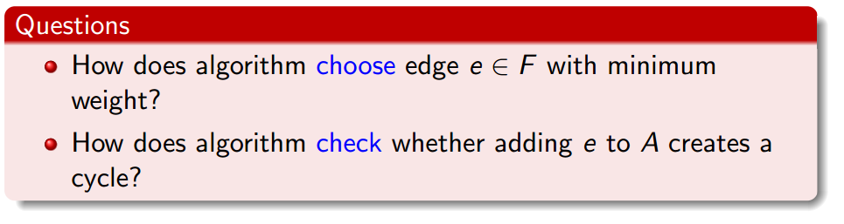
The Framework of Kruskal’s Algorithm
Set A = ∅ and F = E, the set of all edges.
Choose an edge e in F of minimum weight, and check whether adding e to A creates a cycle.
If "yes", remove e from F.
If "no", move e from F to A.
If F = ∅, stop and output the minimal spanning tree (V,A). Otherwise go to Step 2.

Slide 195

How to Choose the Edge of Least Weight?

Slide 196
How to Choose the Edge of Least Weight?
Answer:
Start by sorting edges in E in order of increasing weight.

Slide 197
How to Choose the Edge of Least Weight?
Answer:
Start by sorting edges in E in order of increasing weight.
Walk through the edges in this order.

Slide 198
How to Choose the Edge of Least Weight?
Answer:
Start by sorting edges in E in order of increasing weight.
Walk through the edges in this order.
(Once edge e causes a cycle it will always cause a cycle, so it can be thrown away.)

Slide 199
How to Check for Cycles?
Observations:

Slide 200
How to Check for Cycles?
Observations:
At each step of the framework algorithm, (V,A) is acyclic so it is a forest.

Slide 201
How to Check for Cycles?
Observations:
At each step of the framework algorithm, (V,A) is acyclic so it is a forest.
If u and v are in the same tree, then adding edge {u,v} to A creates a cycle.

Slide 202
How to Check for Cycles?
Observations:
At each step of the framework algorithm, (V,A) is acyclic so it is a forest.
If u and v are in the same tree, then adding edge {u,v} to A creates a cycle.
If u and v are not in the same tree, then adding edge {u,v} to A does not create a cycle.

Slide 203

How to Check for Cycles?
Observations:
At each step of the framework algorithm, (V,A) is acyclic so it is a forest.
If u and v are in the same tree, then adding edge {u,v} to A creates a cycle.
If u and v are not in the same tree, then adding edge {u,v} to A does not create a cycle.

Slide 204
How to Check for Cycles?
Observations:
At each step of the framework algorithm, (V,A) is acyclic so it is a forest.
If u and v are in the same tree, then adding edge {u,v} to A creates a cycle.
If u and v are not in the same tree, then adding edge {u,v} to A does not create a cycle.
High-Level Answer: Use a disjoint-set data structure

Slide 205
How to Check for Cycles?
Observations:
At each step of the framework algorithm, (V,A) is acyclic so it is a forest.
If u and v are in the same tree, then adding edge {u,v} to A creates a cycle.
If u and v are not in the same tree, then adding edge {u,v} to A does not create a cycle.
High-Level Answer: Use a disjoint-set data structure
Vertices in a tree are considered to be in same set.

Slide 206
How to Check for Cycles?
Observations:
At each step of the framework algorithm, (V,A) is acyclic so it is a forest.
If u and v are in the same tree, then adding edge {u,v} to A creates a cycle.
If u and v are not in the same tree, then adding edge {u,v} to A does not create a cycle.
High-Level Answer: Use a disjoint-set data structure
Vertices in a tree are considered to be in same set.
Test if Find-Set(u) = Find-Set(v)?

Slide 207
How to Check for Cycles?
Observations:
At each step of the framework algorithm, (V,A) is acyclic so it is a forest.
If u and v are in the same tree, then adding edge {u,v} to A creates a cycle.
If u and v are not in the same tree, then adding edge {u,v} to A does not create a cycle.
High-Level Answer: Use a disjoint-set data structure
Vertices in a tree are considered to be in same set.
Test if Find-Set(u) = Find-Set(v)?
Low-Level Answer:
The Union-Find data structure implements this

Slide 208
Outline
Review to Part IV
Minimum Spanning Trees
Spanning trees
Minimum spanning trees
Prim’s algorithm
The idea
The algorithm
Analysis for Prim’s algorithm
Kruskal’s algorithm
The idea
The algorithm
The Disjoint Set Union-Find data structure
Analysis for Kruskal’s algorithm

Slide 209
The Union-Find Data Structure
Union-Find supports three operations on collections of disjoint sets over some universe U. Let n = |U|. For any u,v∈U:

Slide 210
The Union-Find Data Structure
Union-Find supports three operations on collections of disjoint sets over some universe U. Let n = |U|. For any u,v∈U:
Create-Set(u): Create a set containing the single element u.
O(1) time

Slide 211
The Union-Find Data Structure
Union-Find supports three operations on collections of disjoint sets over some universe U. Let n = |U|. For any u,v∈U:
Create-Set(u): Create a set containing the single element u.
O(1) time
Find-Set(u): Find the set containing the element u. (Say each set has a unique ID)
O(log n) time

Slide 212
The Union-Find Data Structure
Union-Find supports three operations on collections of disjoint sets over some universe U. Let n = |U|. For any u,v∈U:
Create-Set(u): Create a set containing the single element u.
O(1) time
Find-Set(u): Find the set containing the element u. (Say each set has a unique ID)
O(log n) time
Union(u, v): Merge the sets containing u and v respectively into a common set.
O(log n) time

Slide 213
The Union-Find Data Structure
Union-Find supports three operations on collections of disjoint sets over some universe U. Let n = |U|. For any u,v∈U:
Create-Set(u): Create a set containing the single element u.
O(1) time
Find-Set(u): Find the set containing the element u. (Say each set has a unique ID)
O(log n) time
Union(u, v): Merge the sets containing u and v respectively into a common set.
O(log n) time
For now we treat Union-Find as a black box. We will present its implementation.

Slide 214
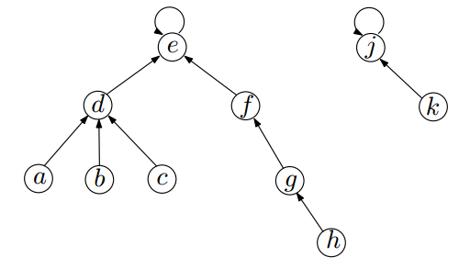
Up-Tree Implementation
Every item is in a tree. (Do not confuse these with the subtrees formed by Kruskal’s algorithm.)

Slide 215
Up-Tree Implementation
Every item is in a tree. (Do not confuse these with the subtrees formed by Kruskal’s algorithm.)
The root of the tree is the representative item of all items in that tree

Slide 216
Up-Tree Implementation
Every item is in a tree. (Do not confuse these with the subtrees formed by Kruskal’s algorithm.)
The root of the tree is the representative item of all items in that tree
i.e., the root of the tree represents the whole items.

Slide 217
Up-Tree Implementation
Every item is in a tree. (Do not confuse these with the subtrees formed by Kruskal’s algorithm.)
The root of the tree is the representative item of all items in that tree
i.e., the root of the tree represents the whole items.
use the root’s ID as the unique ID of the set.

Slide 218
Up-Tree Implementation
Every item is in a tree. (Do not confuse these with the subtrees formed by Kruskal’s algorithm.)
The root of the tree is the representative item of all items in that tree
i.e., the root of the tree represents the whole items.
use the root’s ID as the unique ID of the set.
In this up-tree implementation, every node (except the root) has a pointer pointing to its parent.

Slide 219
Up-Tree Implementation
Every item is in a tree. (Do not confuse these with the subtrees formed by Kruskal’s algorithm.)
The root of the tree is the representative item of all items in that tree
i.e., the root of the tree represents the whole items.
use the root’s ID as the unique ID of the set.
In this up-tree implementation, every node (except the root) has a pointer pointing to its parent.
The root element has a pointer pointing to itself.

Slide 220
Create-Set(x) and Find-Set(x)
Create-Set(x): easy

Slide 221
Create-Set(x) and Find-Set(x)
Create-Set(x): easy
Find-Set(x): also easy
simply trace the parent point until we hit the root, then return the root element.

Slide 222
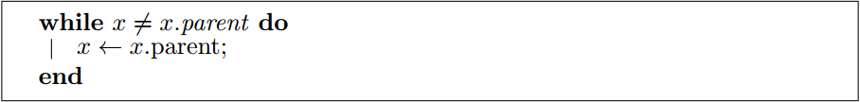
Create-Set(x) and Find-Set(x)
Create-Set(x): easy
Find-Set(x): also easy
simply trace the parent point until we hit the root, then return the root element.

Slide 223
Union(x, y)
Naive solution:
put the parent pointer of the representation of x pointing to the representation of y.

Slide 224
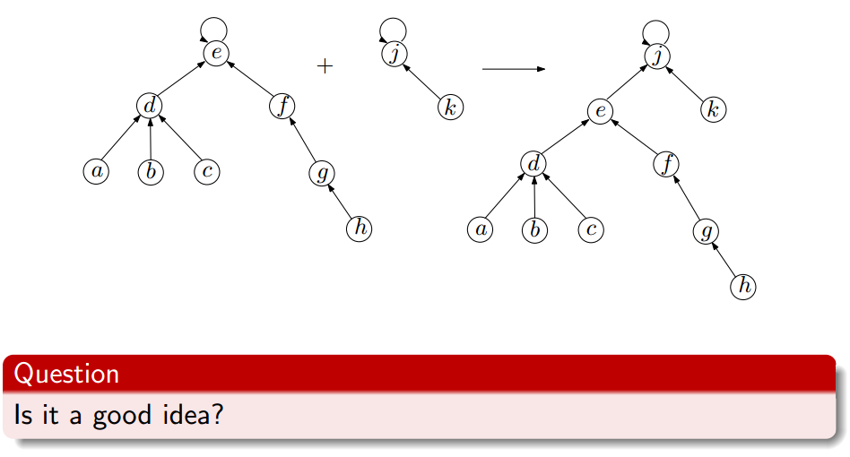
Union(x, y)
Naive solution:
put the parent pointer of the representation of x pointing to the representation of y.

Slide 225
Union(x, y)
Naive solution:
put the parent pointer of the representation of x pointing to the representation of y.

Slide 226
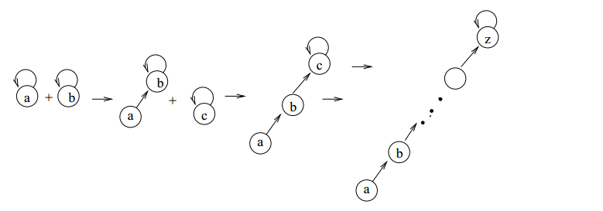
Union(x, y)

Slide 227
Union(x, y)
May become a linked-list at the end! Hence it is not efficient.

Slide 228

Union(x, y)
May become a linked-list at the end! Hence it is not efficient.

Slide 229
Union(x, y)
May become a linked-list at the end! Hence it is not efficient.
Simple trick (Union by height):

Slide 230
Union(x, y)
May become a linked-list at the end! Hence it is not efficient.
Simple trick (Union by height):
when we union two trees together, we always make the root of the taller tree the parent of shorter tree.

Slide 231
Up-Tree Implementation : Union by Height
The root of every tree also holds the height of the tree.

Slide 232
Up-Tree Implementation : Union by Height
The root of every tree also holds the height of the tree.
In case two trees have the same height, we choose the root of the first tree point to the root of the second.

Slide 233
Up-Tree Implementation : Union by Height
The root of every tree also holds the height of the tree.
In case two trees have the same height, we choose the root of the first tree point to the root of the second. And the tree height is increased by 1.

Slide 234
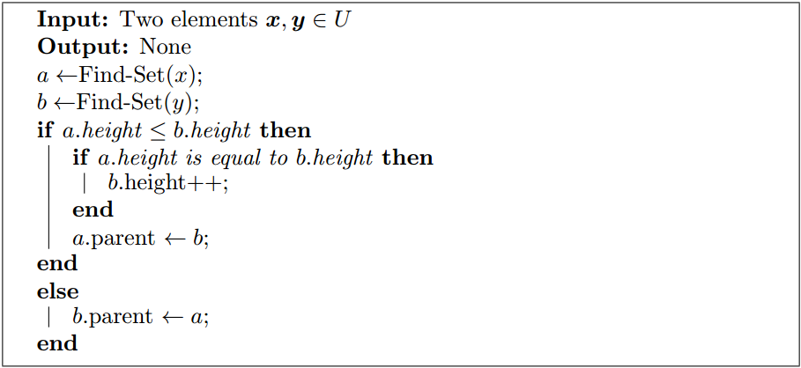
Up-Tree Implementation : Union by Height
The root of every tree also holds the height of the tree.
In case two trees have the same height, we choose the root of the first tree point to the root of the second. And the tree height is increased by 1.

Slide 235
Up-Tree Implementation : Union by Height
The root of every tree also holds the height of the tree.
In case two trees have the same height, we choose the root of the first tree point to the root of the second. And the tree height is increased by 1.

Slide 236
Up-Tree Implementation : Union by Height
The root of every tree also holds the height of the tree.
In case two trees have the same height, we choose the root of the first tree point to the root of the second. And the tree height is increased by 1.

Slide 237
Up-Tree Implementation : Union by Height
The root of every tree also holds the height of the tree.
In case two trees have the same height, we choose the root of the first tree point to the root of the second. And the tree height is increased by 1.

Slide 238
Up-Tree Implementation : Union by Height
The root of every tree also holds the height of the tree.
In case two trees have the same height, we choose the root of the first tree point to the root of the second. And the tree height is increased by 1.

Slide 239
Up-Tree Implementation : Union by Height
The root of every tree also holds the height of the tree.
In case two trees have the same height, we choose the root of the first tree point to the root of the second. And the tree height is increased by 1.

Slide 240
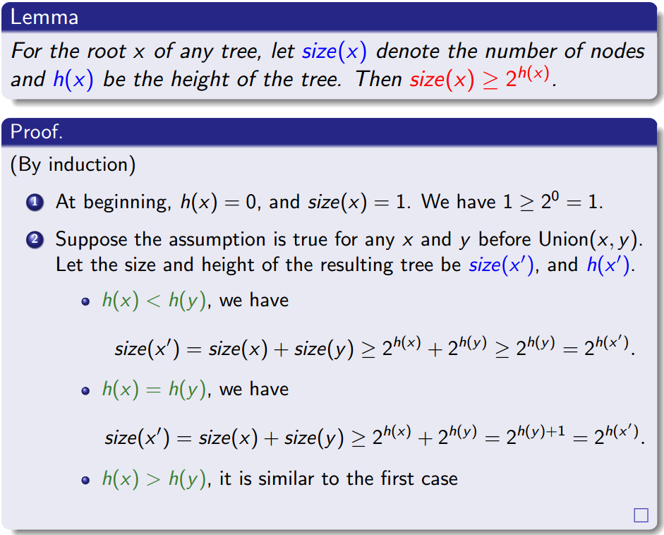
Lemma

Slide 241
Lemma

Slide 242
Lemma

Slide 243
Lemma

Slide 244
Lemma

Slide 245
Lemma

Slide 246
Lemma

Slide 247
Lemma

Slide 248
Lemma

Slide 249
Lemma

Slide 250
Lemma

Slide 251
Lemma

Slide 252
Lemma

Slide 253
Lemma

Slide 254
Lemma

Slide 255
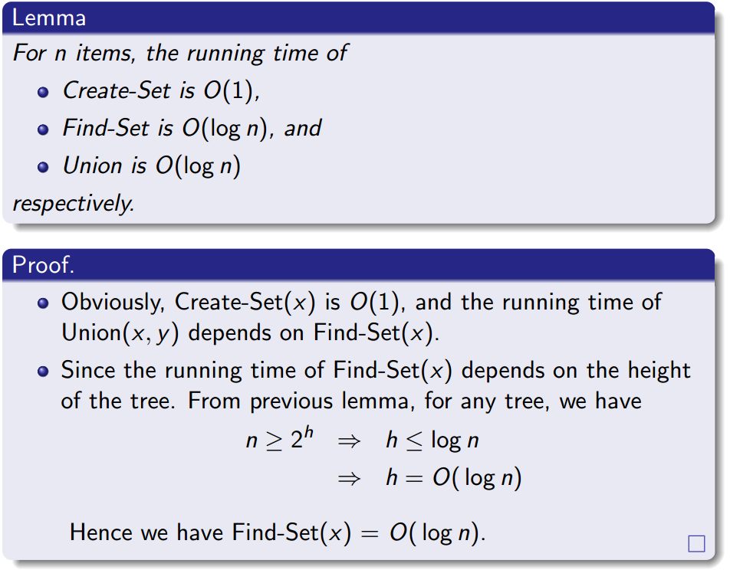
Lemma

Slide 256
Lemma

Slide 257
Lemma

Slide 258
Lemma

Slide 259
Lemma

Slide 260
Lemma

Slide 261
Lemma

Slide 262
Outline
Review to Part IV
Minimum Spanning Trees
Spanning trees
Minimum spanning trees
Prim’s algorithm
The idea
The algorithm
Analysis for Prim’s algorithm
Kruskal’s algorithm
The idea
The algorithm
The Disjoint Set Union-Find data structure
Analysis for Kruskal’s algorithm

Slide 263
Why Kruskal’s Algorithm is Correct?
Let A be the edge set selected by Kruskal’s Algorithm, and let (u, v) be the edge to be added next. It suffices to show that

Slide 264
Why Kruskal’s Algorithm is Correct?
Let A be the edge set selected by Kruskal’s Algorithm, and let (u, v) be the edge to be added next. It suffices to show that
there is a cut that respects A, and

Slide 265
Why Kruskal’s Algorithm is Correct?
Let A be the edge set selected by Kruskal’s Algorithm, and let (u, v) be the edge to be added next. It suffices to show that
there is a cut that respects A, and
(u, v) is the light edge crossing this cut

Slide 266
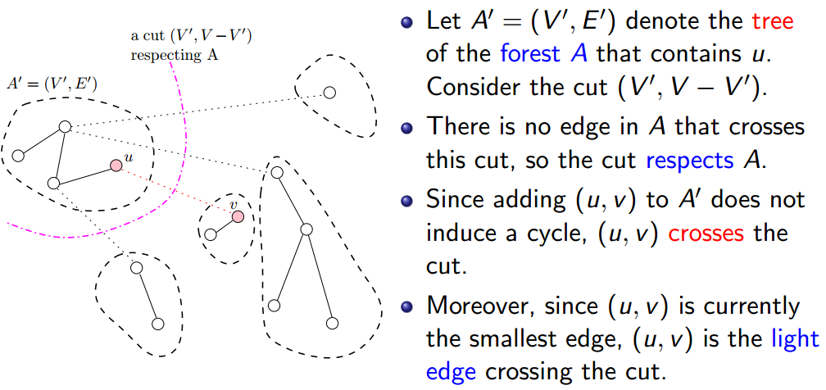
Why Kruskal’s Algorithm is Correct?
Let A be the edge set selected by Kruskal’s Algorithm, and let (u, v) be the edge to be added next. It suffices to show that
there is a cut that respects A, and
(u, v) is the light edge crossing this cut

Slide 267
Why Kruskal’s Algorithm is Correct?
Let A be the edge set selected by Kruskal’s Algorithm, and let (u, v) be the edge to be added next. It suffices to show that
there is a cut that respects A, and
(u, v) is the light edge crossing this cut

Slide 268
Why Kruskal’s Algorithm is Correct?
Let A be the edge set selected by Kruskal’s Algorithm, and let (u, v) be the edge to be added next. It suffices to show that
there is a cut that respects A, and
(u, v) is the light edge crossing this cut

Slide 269
Why Kruskal’s Algorithm is Correct?
Let A be the edge set selected by Kruskal’s Algorithm, and let (u, v) be the edge to be added next. It suffices to show that
there is a cut that respects A, and
(u, v) is the light edge crossing this cut

Slide 270
Why Kruskal’s Algorithm is Correct?
Let A be the edge set selected by Kruskal’s Algorithm, and let (u, v) be the edge to be added next. It suffices to show that
there is a cut that respects A, and
(u, v) is the light edge crossing this cut

Slide 271
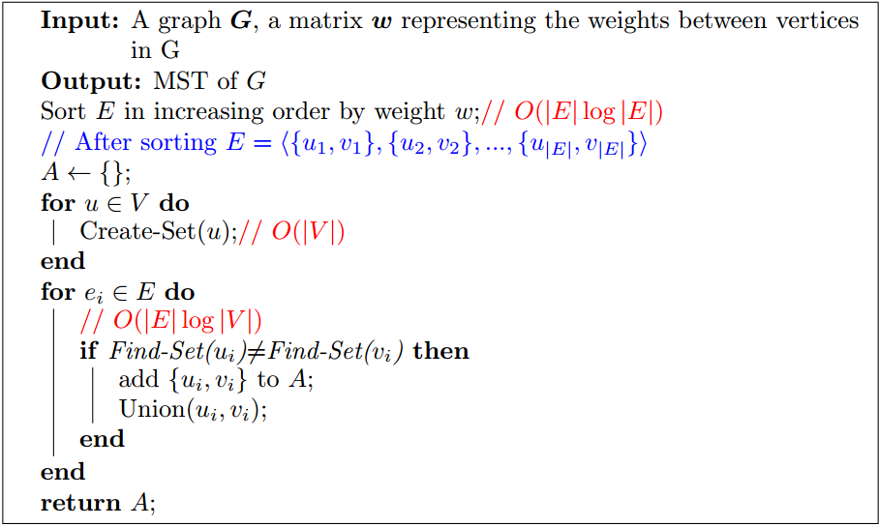
Time Complexity of Kruskal’s Algorithm

Slide 272
Time Complexity of Kruskal’s Algorithm

Slide 273
Time Complexity of Kruskal’s Algorithm

Slide 274
Time Complexity of Kruskal’s Algorithm

Slide 275
Time Complexity of Kruskal’s Algorithm

Slide 276
Time Complexity of Kruskal’s Algorithm

Slide 277
Time Complexity of Kruskal’s Algorithm

Slide 278
Time Complexity of Kruskal’s Algorithm

Slide 279
Time Complexity of Kruskal’s Algorithm

Slide 280
Time Complexity of Kruskal’s Algorithm

Slide 281
Time Complexity of Kruskal’s Algorithm

Slide 282
Time Complexity of Kruskal’s Algorithm

Slide 283
Time Complexity of Kruskal’s Algorithm

Slide 284
Time Complexity of Kruskal’s Algorithm
Remark: With a proper implementation of Union-Find, Kruskal’s algorithm has running time O(|E|log|E|) = O(|E|log|V|).

Slide 285
Time Complexity of Kruskal’s Algorithm
Remark: With a proper implementation of Union-Find, Kruskal’s algorithm has running time O(|E|log|E|) = O(|E|log|V|).
log|E|≤ log|V|²=2log|V|=O(log|V|)

Slide 286
Summary
Prim’s algorithm always grows one tree.
Kruskal’s algorithm grows a collection of trees, namely a forest.
Both Prim’s algorithm and Kruskal’s algorithm take O(|E|log|V|) time, but they adopt different data structures.

Slide 287


